Slide 1

HOUSING PRICE PREDICTION PROJECT
Submitted by :
Naina Joshi

Slide 2
TABLE OF CONTENTS
INTRODUCTION
BUSINESS PROBLEM FRAMING
CONCEPTUAL BACKGROUND OF THE DOMAIN PROBLEM
REVIEW OF LITERATURE
MOTIVATION FOR THE PROBLEM UNDERTAKEN
ANALYTICAL PROBLEM FRAMING
MATHEMATICAL/ ANALYTICAL MODELING OF THE PROBLEM
DATA SOURCES AND THEIR FORMATS
DATA PREPROCESSING DONE
DATA INPUTS- LOGIC- OUTPUT RELATIONSHIPS
HARDWARE AND SOFTWARE REQUIREMENTS AND TOOLS USED
MODEL/S DEVELOPMENT AND EVALUATION
IDENTIFICATION OF POSSIBLE PROBLEM-SOLVING APPROACHES (METHODS)
TESTING OF IDENTIFIED APPROACHES (ALGORITHMS)
RUN AND EVALUATE SELECTED MODELS
KEY METRICS FOR SUCCESS IN SOLVING PROBLEM UNDER CONSIDERATION
VISUALIZATIONS

Slide 3
INTERPRETATION OF THE RESULTS
CONCLUSION
KEY FINDINGS AND CONCLUSIONS OF THE STUDY
LEARNING OUTCOMES OF THE STUDY IN RESPECT OF DATA SCIENCE
LIMITATIONS OF THIS WORK AND SCOPE FOR FUTURE WORK

Slide 4


INTRODUCTION

Slide 5
A US-based housing company named Surprise Housing has decided to enter the Australian market.
The company uses data analytics to purchase houses at a price below their actual values and flip them at a higher price. For the same purpose, the company has collected a data set from the sale of houses in Australia.
We are required to build a model using Machine Learning in order to predict the actual value of the prospective properties and decide whether to invest in them or not.
BUSINESS PROBLEM FRAMING

Slide 6
In real estate the value of property usually increases with time as seen in many countries. One of the causes for this is due to rising population.
The value of property also depends on the proximity of the property, its size its neighborhood and audience for which the property is subjected to be sold.
The company is looking at prospective properties to buy houses to enter the market. We are required to build a model using Machine Learning in order to predict the actual value of the prospective properties and decide whether to invest in them or not.
CONCEPTUAL BACKGROUND OF THE DOMAIN PROBLEM

Slide 7
REVIEW OF LITERATURE
Houses are one of the necessary needs of each and every person around the globe and therefore housing and real estate market is one of the markets which is one of the major contributors in the world’s economy.
A US-based housing company named Surprise Housing has decided to enter the Australian market. The company uses data analytics to purchase houses at a price below their actual values and flip them at a higher price.
We are required to build a model using Machine Learning in order to predict the actual value of the prospective properties and decide whether to invest in them or not.

Slide 8
Houses are one of the necessary need of each person around the globe and therefore housing and real estate market is one of the markets which is one of the major contributors in the world’s economy.
It is a very large market and there are various companies working in the domain.
Data science comes as a very important tool to solve problems in the domain to help the companies increase their overall revenue, profits, improving their marketing strategies and focusing on changing trends in house sales and purchases.
MOTIVATION FOR THE PROBLEM UNDERTAKEN

Slide 9

MOTIVATION FOR THE PROBLEM UNDERTAKEN
Predictive modelling, Market mix modelling, recommendation systems are some of the machine learning techniques used for achieving the business goals for housing companies. Our problem is related to one such housing company.

Slide 10
ANALYTICAL PROBLEM
FRAMING

Slide 11
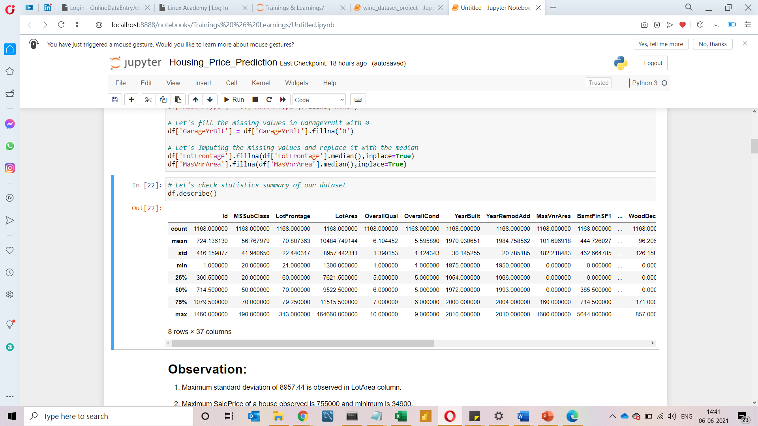
MATHEMATICAL/ ANALYTICAL MODELING OF THE PROBLEM
In this project we have performed various mathematical and statistical analysis such as we checked description or statistical summary of the data using describe, checked correlation using corr and also visualized it using heatmap. Then we have used Z-Score to plot outliers and remove them.

Slide 12

MATHEMATICAL/ ANALYTICAL MODELING OF THE PROBLEM
From this statistical analysis we make some of the interpretations that,
Maximum standard deviation of 8957.44 is observed in LotArea column.
Maximum SalePrice of a house observed is 755000 and minimum is 34900.
In the columns Id, MSSubclass, LotArea, MasVnrArea, BsmtFinSF1, BsmtFinSF2, BsmtUnfsF, TotalBsmtSF, 1stFlrSF, 2ndFlrSF, LowQualFinSF, GrLivArea, BsmtFullBath, HalfBath, TotRmsAbvGrd, WoodDeckSF, OpenPorchSF, EnclosedPorch, 3SsnPorch, ScreenPorch, PoolArea, Miscval,

Slide 13
MATHEMATICAL/ ANALYTICAL MODELING OF THE PROBLEM
salePrice mean is considerably greater than median so the columns are positively skewed.
In the columns FullBath, BedroomAbvGr, Fireplaces, Garagecars, GarageArea, YrSold Median is greater than mean so the columns are negatively skewed.
In the columns Id, MSSubClass, LotFrontage, LotArea, MasVnrArea, BsmtFinSF1, BsmtFinSF2, BsmtUnfSF, TotalBsmtSF, 1stFlrSF, 2ndFlrSF, LowQualFinSF, GrLivArea, BsmtHalfBath, BedroomAbvGr, ToRmsAbvGrd, GarageArea, WoodDeckSF, OpenPorchSF, EnclosedPorch, 3SsnPorch,
ScreenPorch, PoolArea, MiscVal, SalePrice there is considerable difference between the 75 percentile and maximum, so outliers are present.

Slide 14
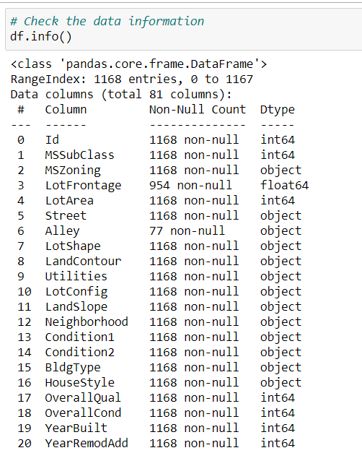
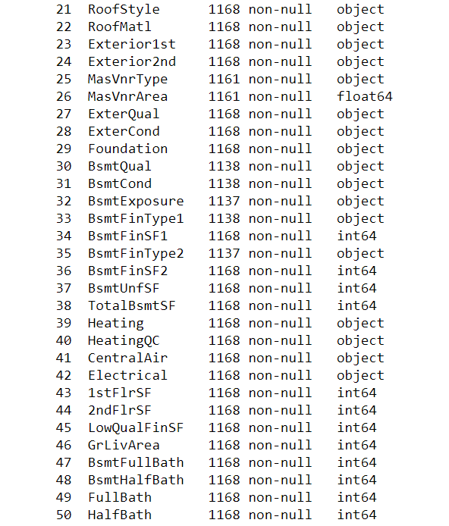
DATA SOURCES AND THEIR FORMATS

Slide 15
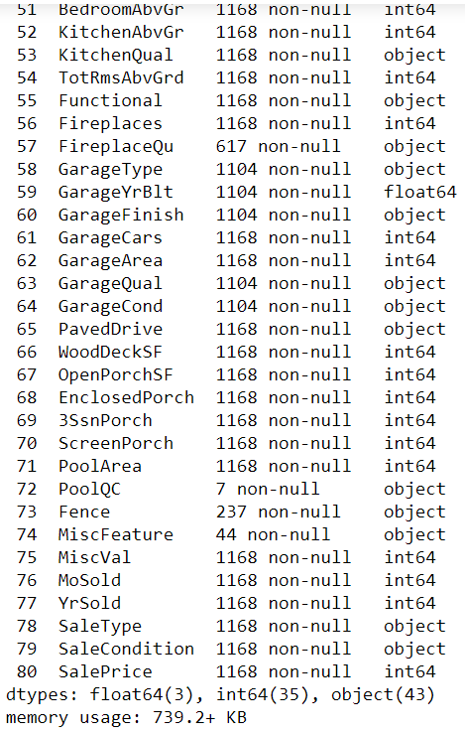
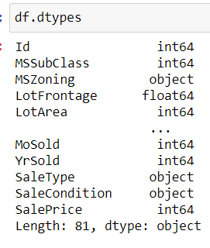
DATA SOURCES AND THEIR FORMATS

Slide 16
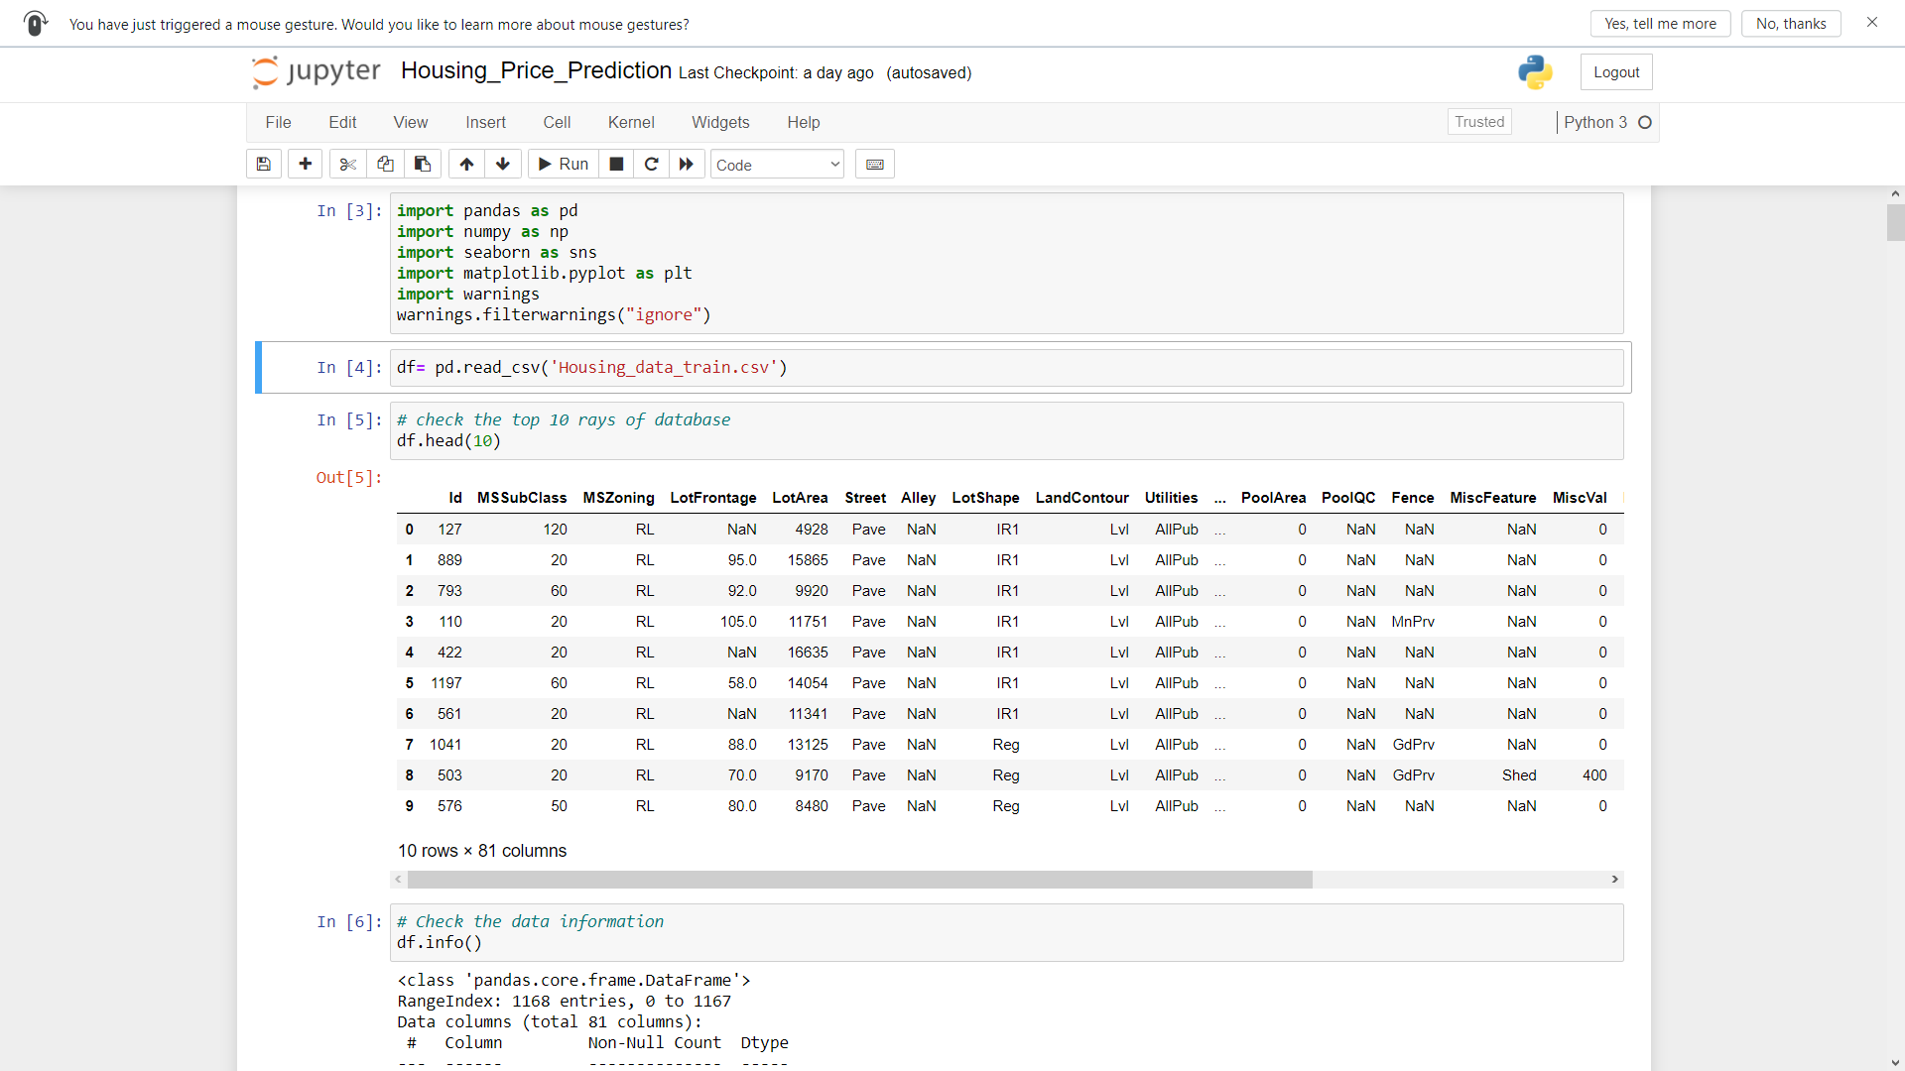
DATA PREPROCESSING DONE
After loading all the required libraries, we loaded the data into our jupyter notebook.

Slide 17
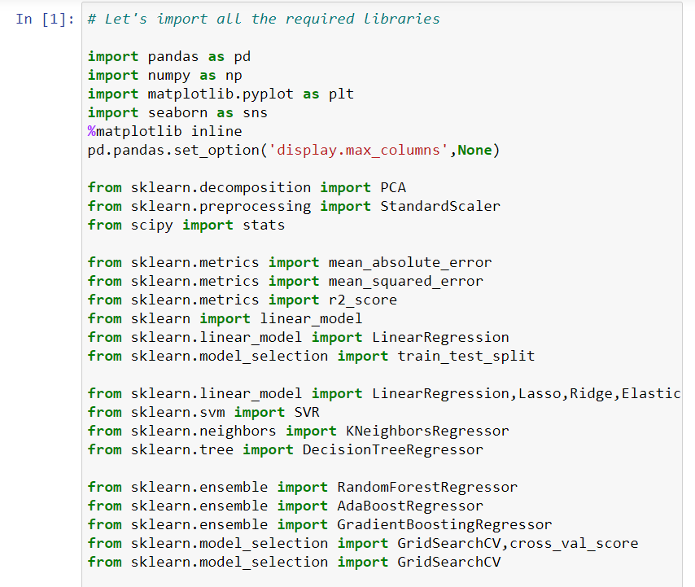
Rest Necessary Libraries

Slide 18

DATA PREPROCESSING DONE
Feature Engineering has been used for cleaning of the data.
Some unused columns have been deleted and even some columns have been bifurcated which was used in the prediction.
We first done data cleaning. We first looked percentage of values missing in columns then we imputed missing values.

Slide 19
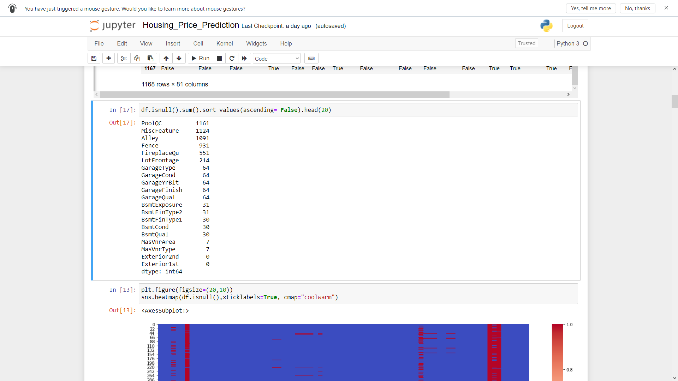
DATA PREPROCESSING DONE

Slide 20
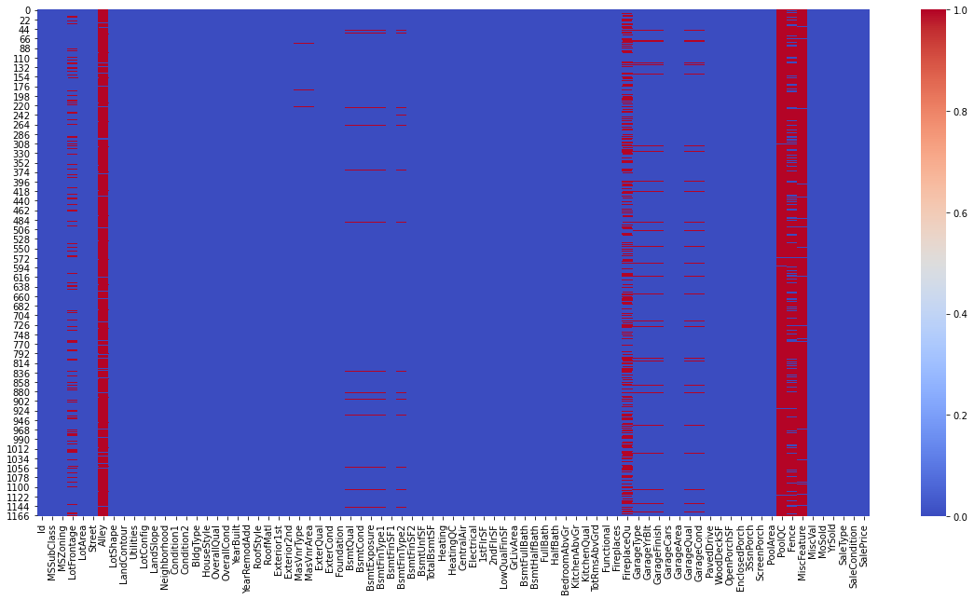
DATA PREPROCESSING DONE

Slide 21
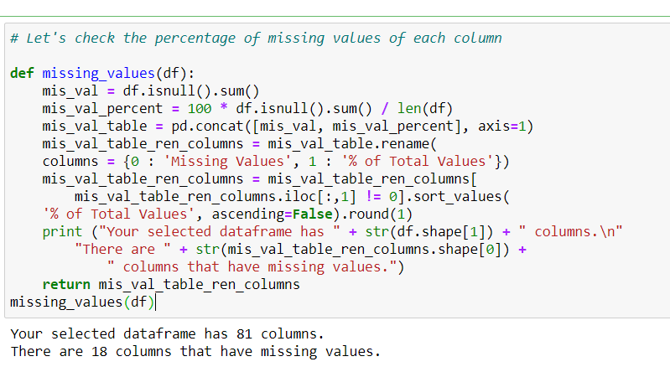
DATA PREPROCESSING DONE

Slide 22
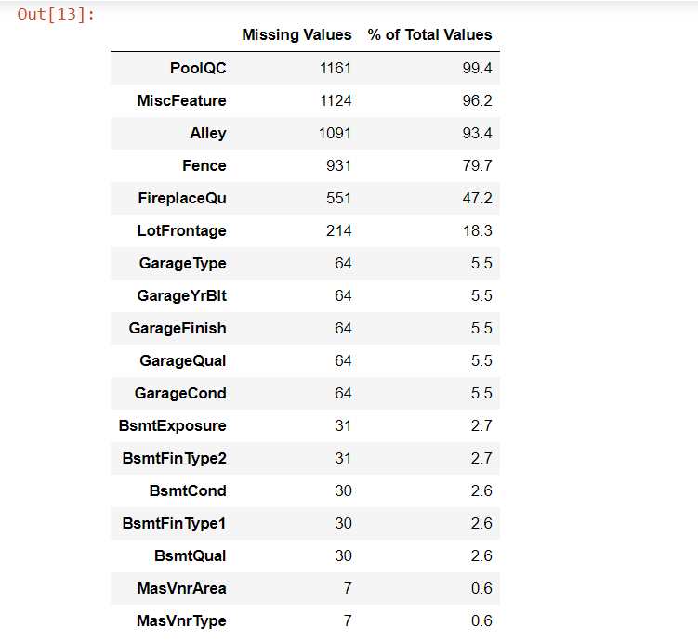
DATA PREPROCESSING DONE

Slide 23
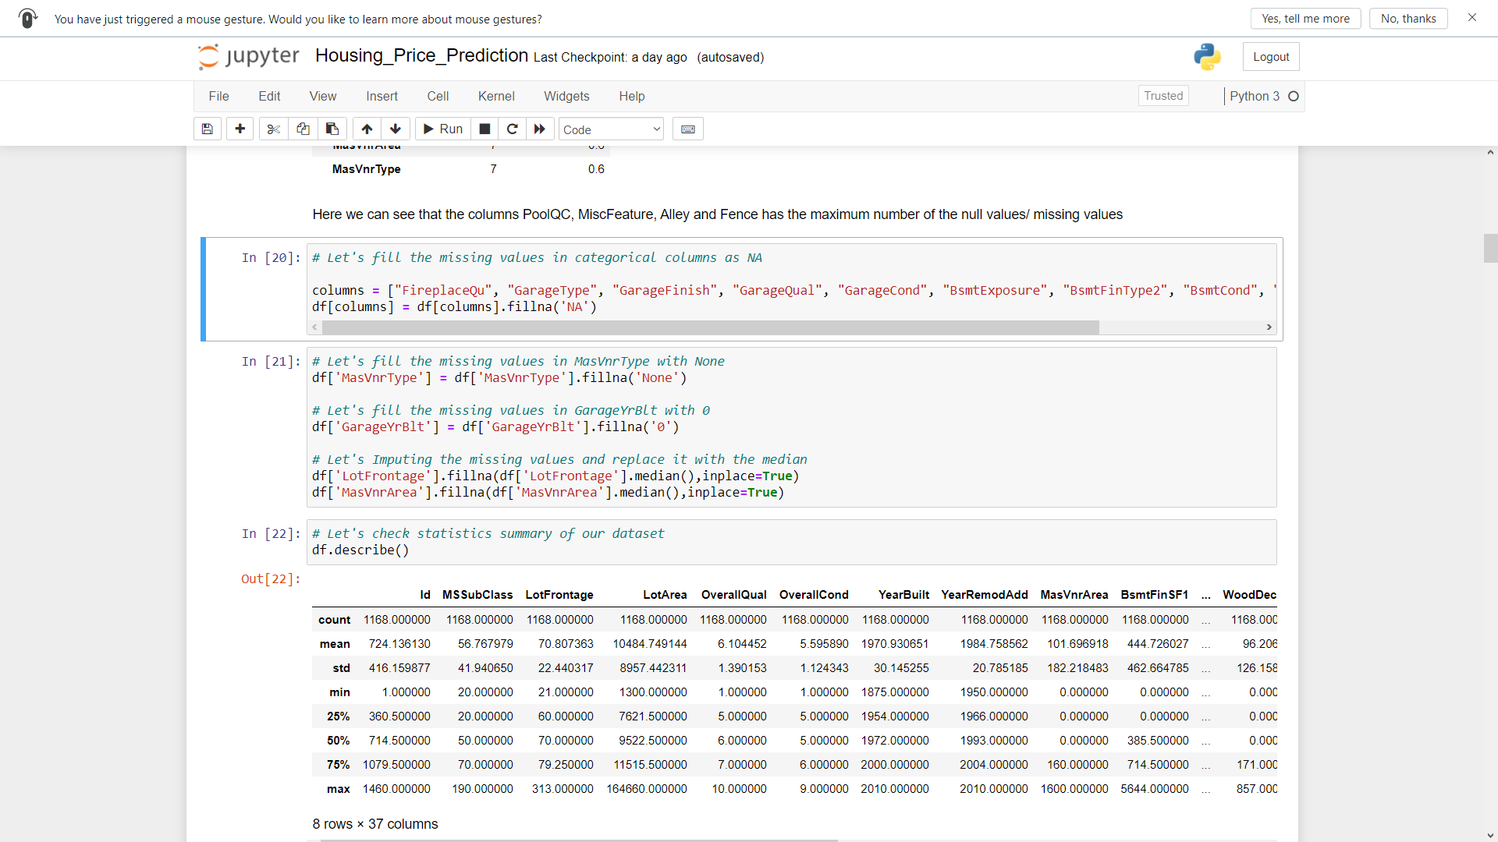
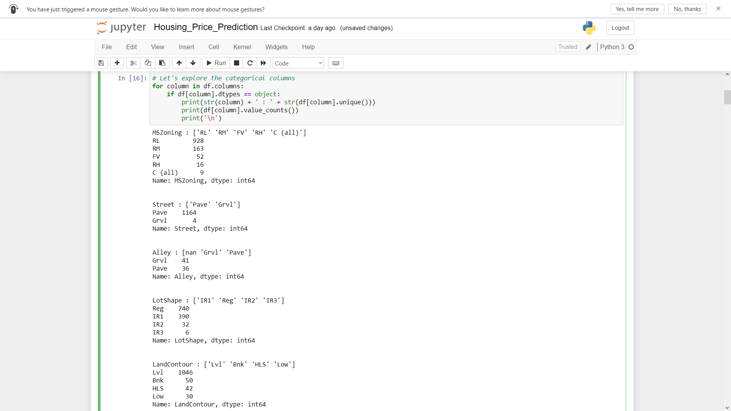
DATA PREPROCESSING DONE

Slide 24
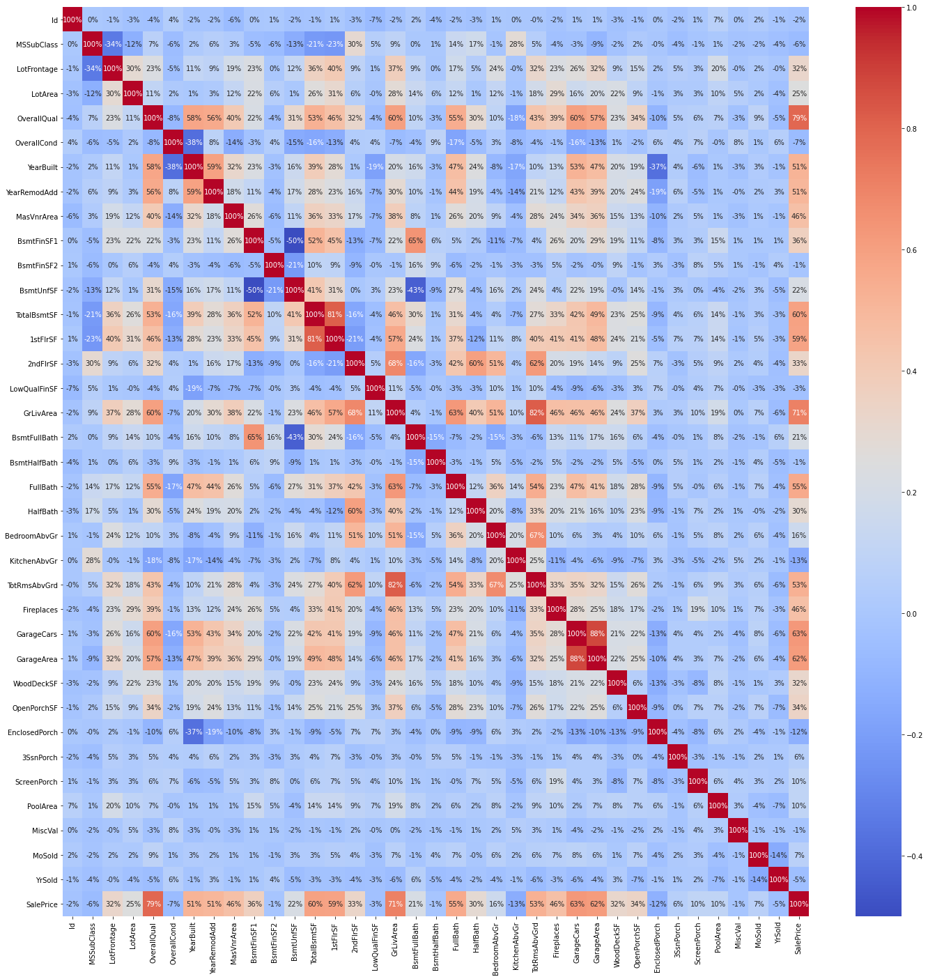
DATA PREPROCESSING DONE
Then we checked the correlation with the help of heatmap.

Slide 25
DATA PREPROCESSING DONE
While checking the heatmap of correlation we observed that:
SalePrice is highly positively correlated with the columns OverallQual, YearBuilt, YearRemodAdd, TotalBsmtSF, 1stFlrSF, GrLivArea, FullBath, TotRmsAbvGrd, GarageCars, GarageArea.
SalePrice is negatively correlated with OverallCond, KitchenAbvGr, Encloseporch, YrSold.
We observe multicollinearity in between columns so we will be using Principal Component Analysis(PCA).
No correlation has been observed between the column Id and other columns so we will be dropping this column.

Slide 26
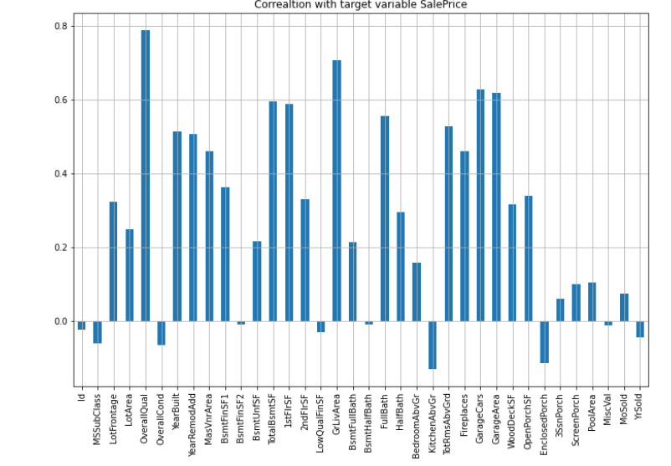
DATA INPUTS- LOGIC- OUTPUT RELATIONSHIPS

Slide 27
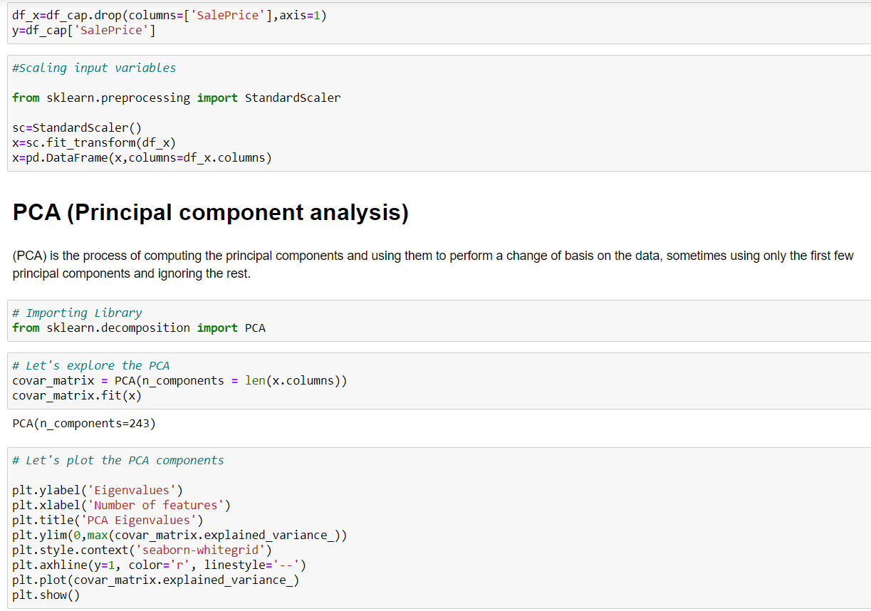
MODEL TRAINNING

Slide 28
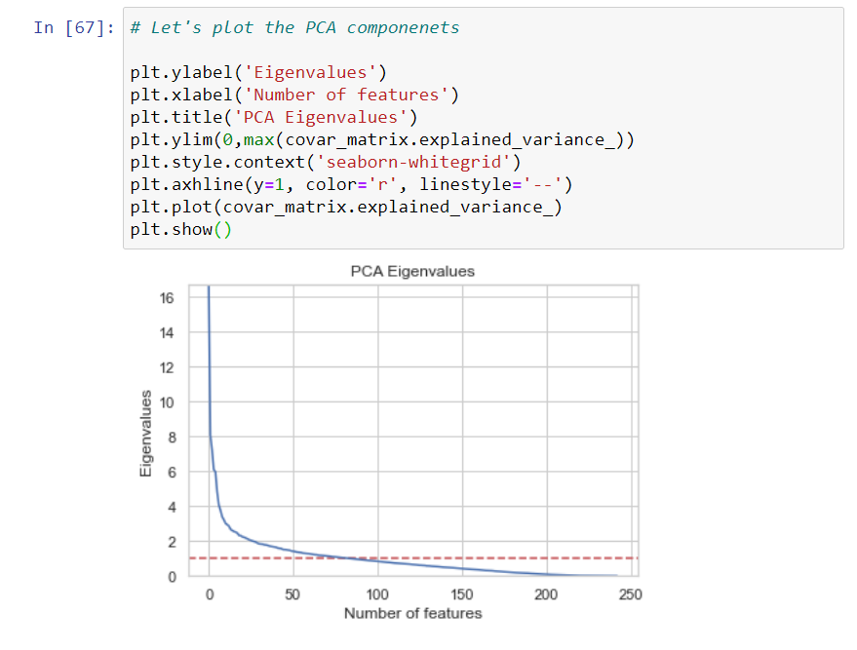
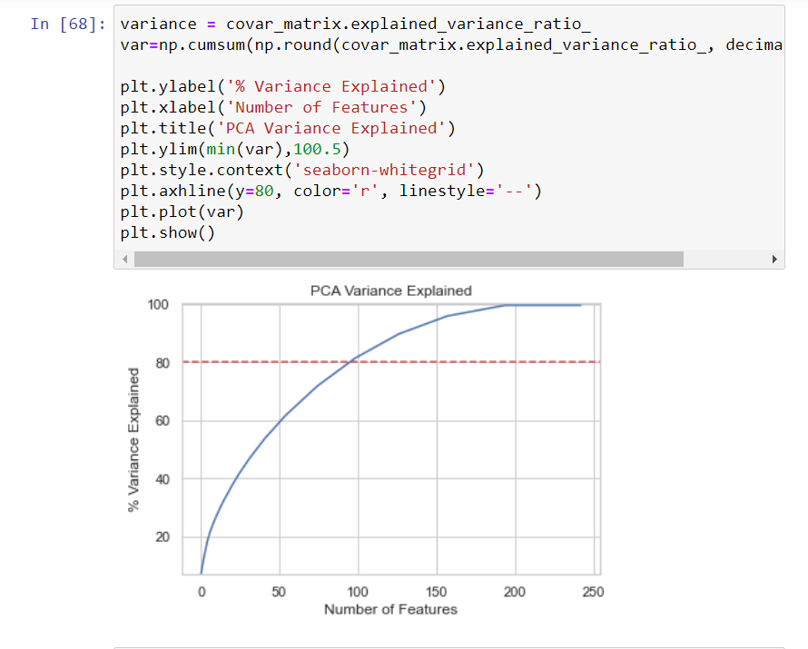
PCA

Slide 29
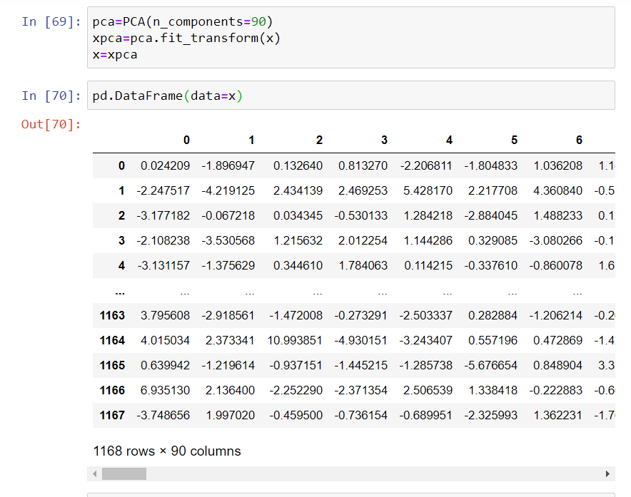
PCA

Slide 30

MODEL/S DEVELOPMENT
AND
EVALUATION

Slide 31

IDENTIFICATION OF POSSIBLE PROBLEM-SOLVING APPROACHES (METHODS)
We first converted all our categorical variables to numeric variables with the help of dummy variables to checkout and dropped the columns which we felt were unnecessary.
We observed skewness in data, so we tried to remove the skewness through treating outliers with Winsorization technique.
The data was improper scaled, so we scaled the feature variables on a single scale using sklearn’s StandardScaler package.
There were too many feature variables in the data, so we reduced it to 100 with the help of Principal Component Analysis(PCA) by plotting Eigenvalues and taking the number of nodes as our number of feature variables.

Slide 32
TESTING OF IDENTIFIED APPROACHES (ALGORITHMS)
The algorithms we used for the training and testing are as follows:-
Linear Regression
Lasso
Ridge
Elastic Net
SVR
KNeighbors Regressor
Decision Tree Regressor
Random Forest Regressor
Ada Boost Regressor
Gradient Boosting Regressor

Slide 33
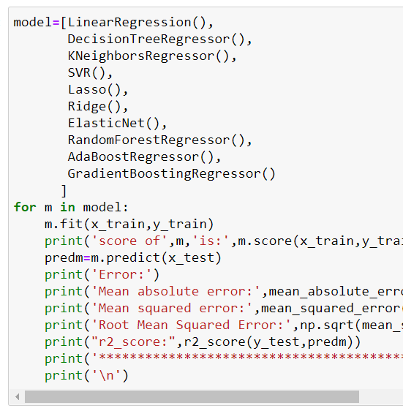
RUN AND EVALUATE SELECTED MODELS

Slide 34
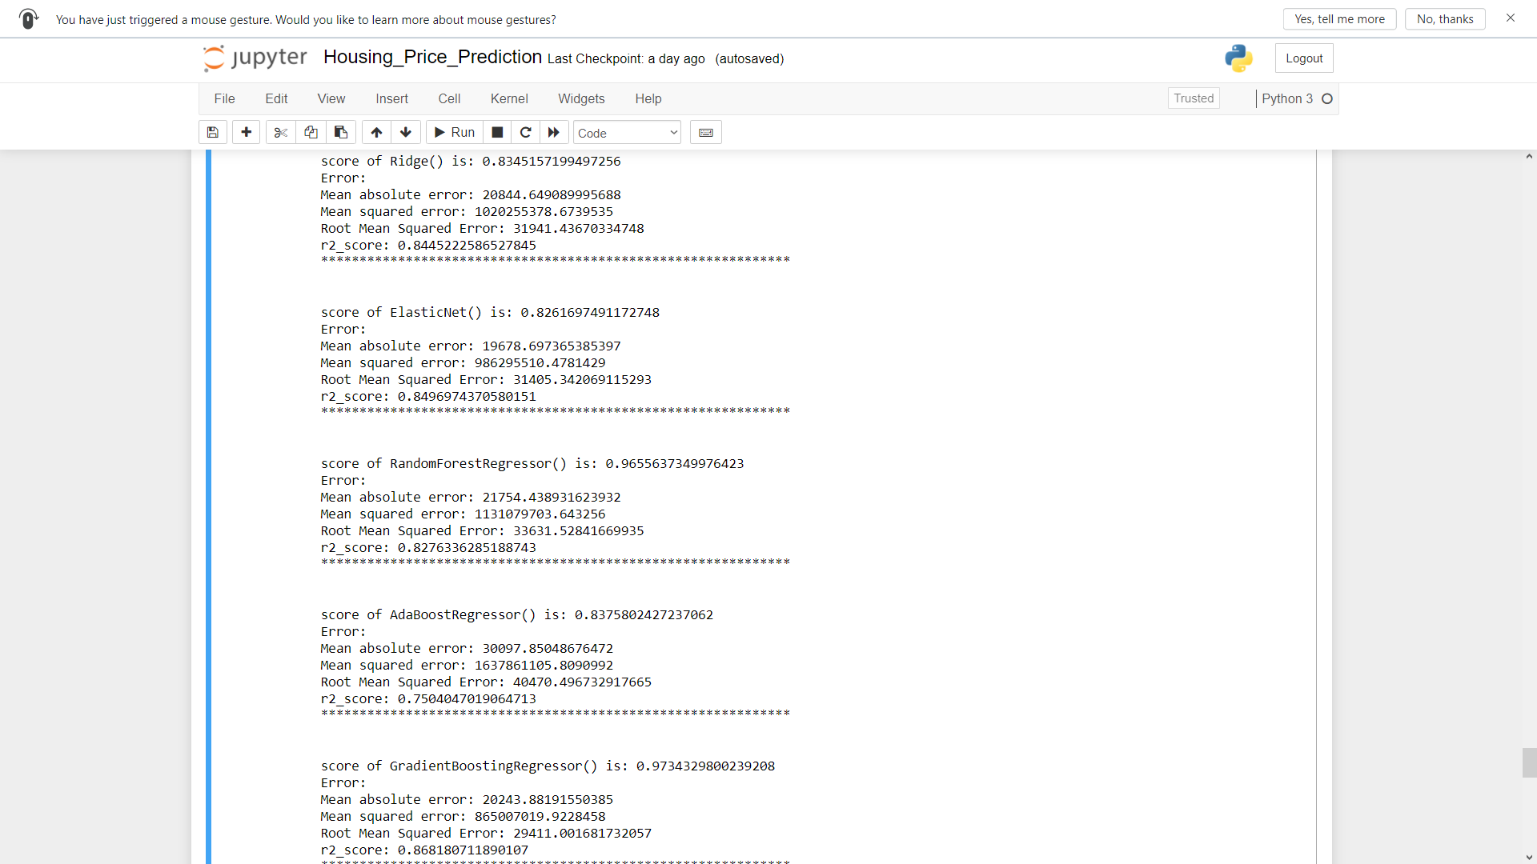
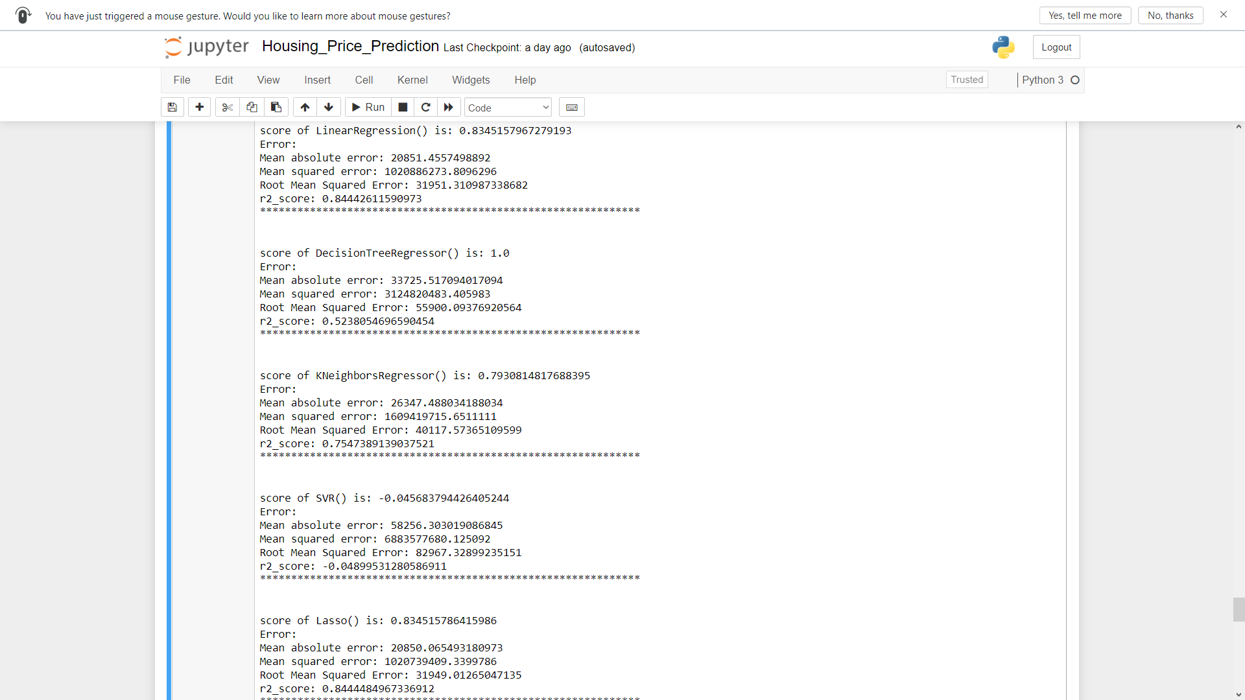
RUN AND EVALUATE SELECTED MODELS

Slide 35

KEY METRICS FOR SUCCESS IN SOLVING PROBLEM UNDER CONSIDERATION
We used the metric Root Mean Squared Error by selecting the Gradient Boosting Regressor model which was giving us best(minimum) RMSE score.

Slide 36
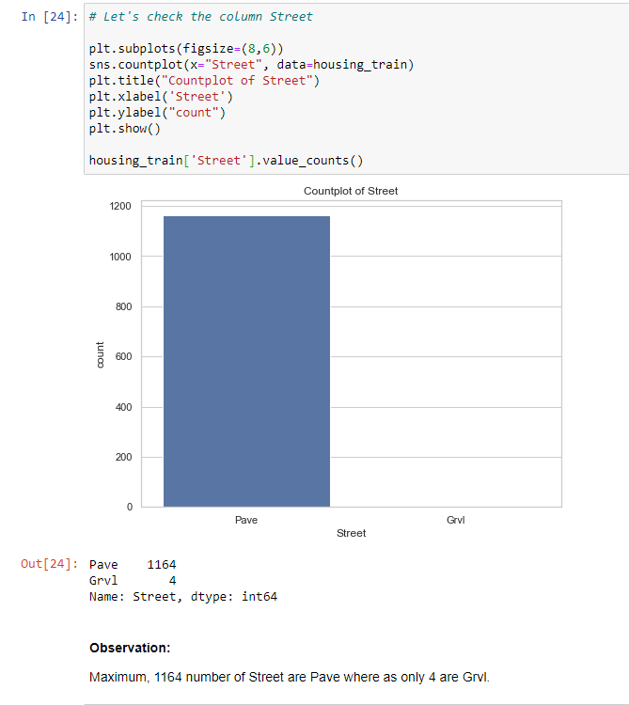
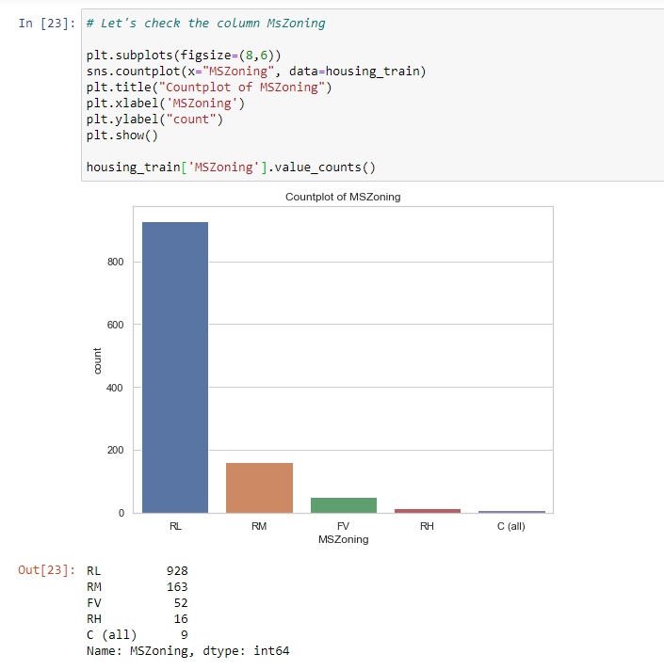
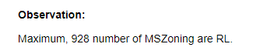
VISUALIZATIONS

Slide 37
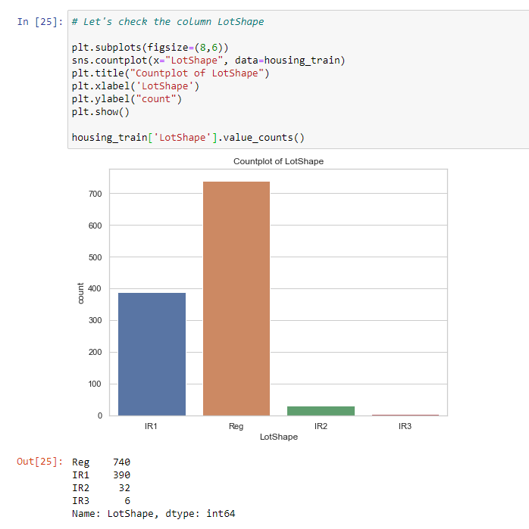
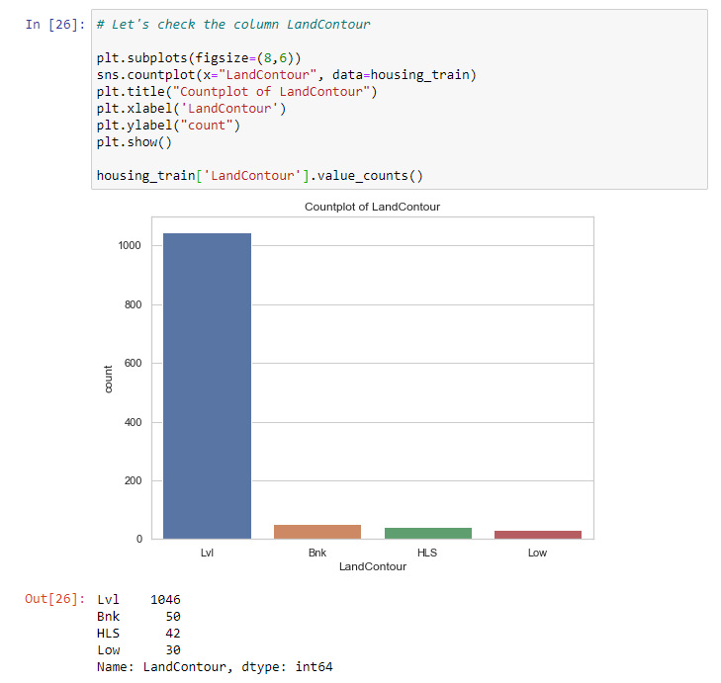
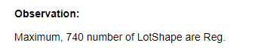
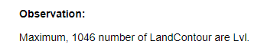
VISUALIZATIONS

Slide 38
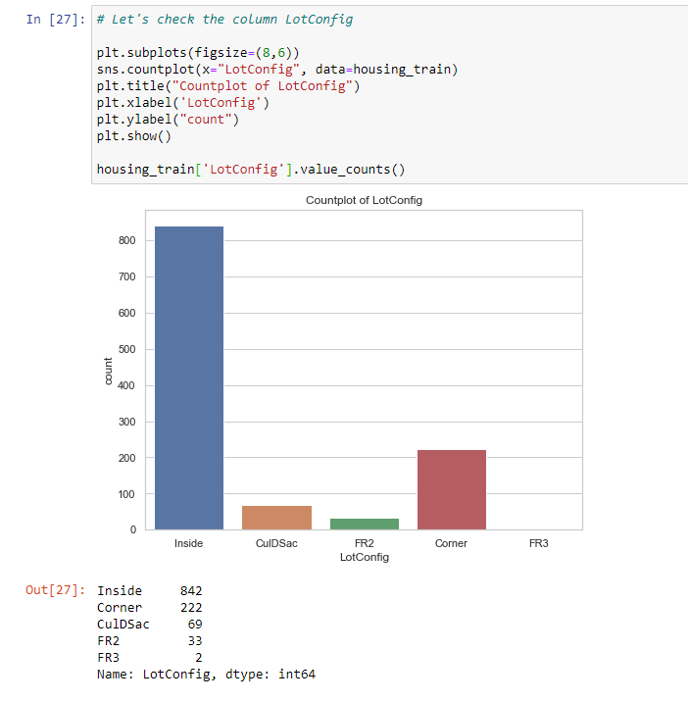
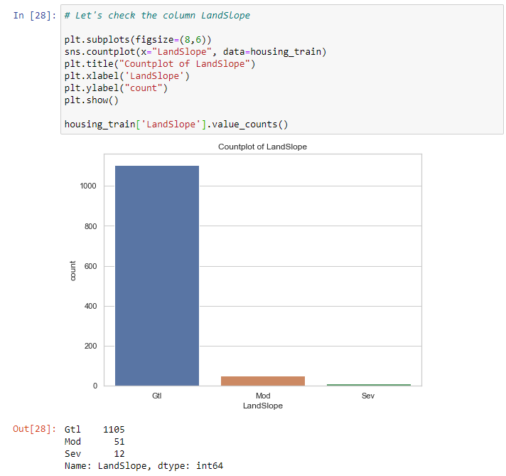
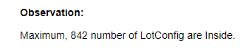
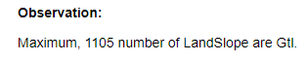
VISUALIZATIONS

Slide 39
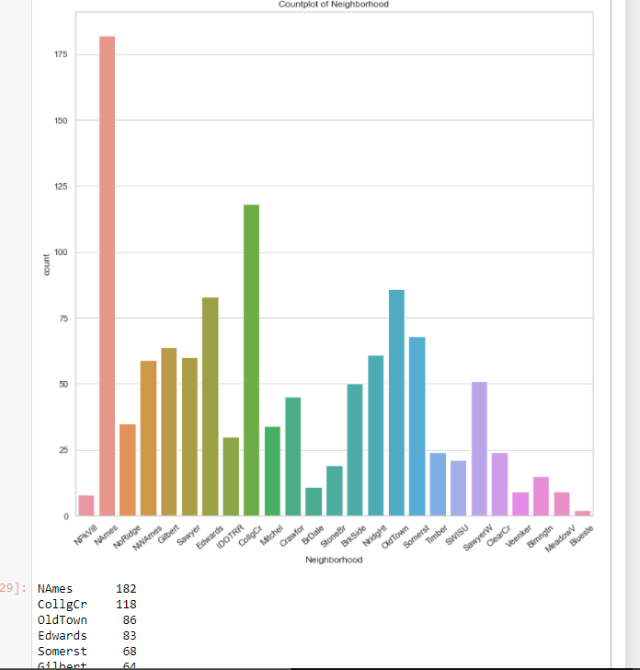
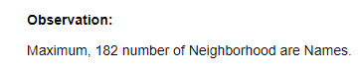
VISUALIZATIONS

Slide 40
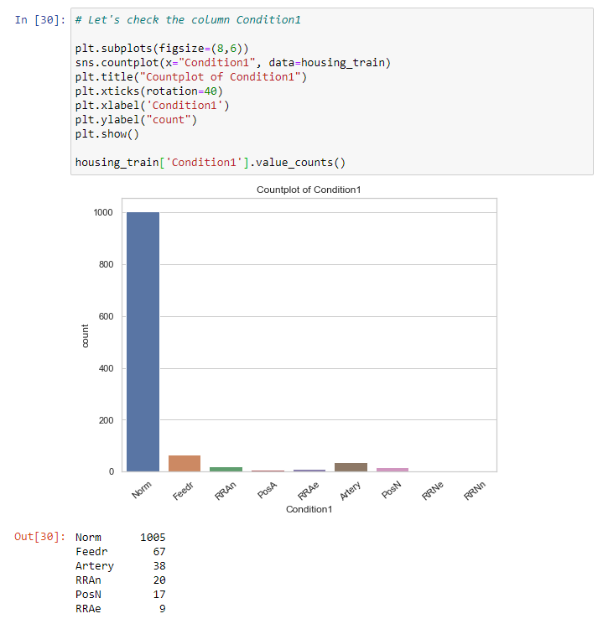
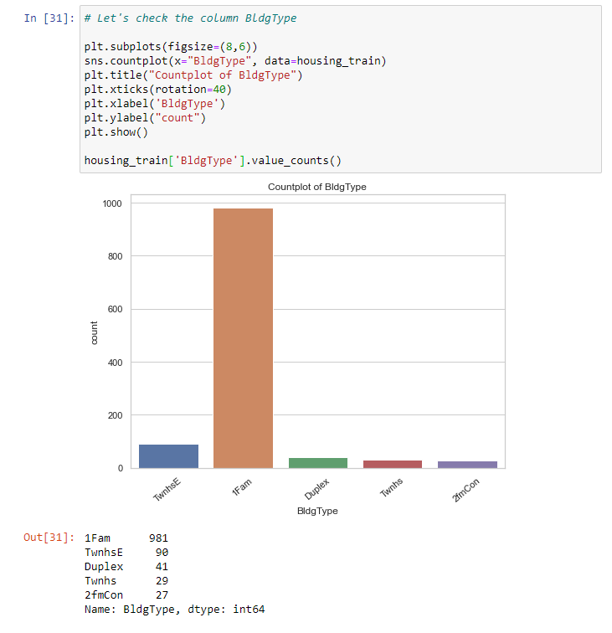
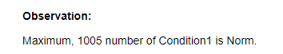
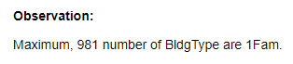
VISUALIZATIONS

Slide 41
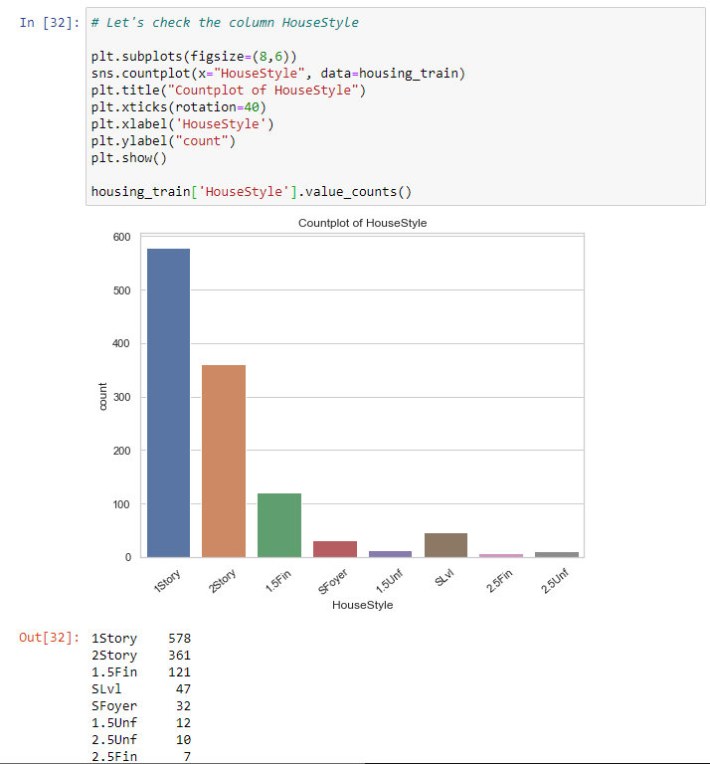
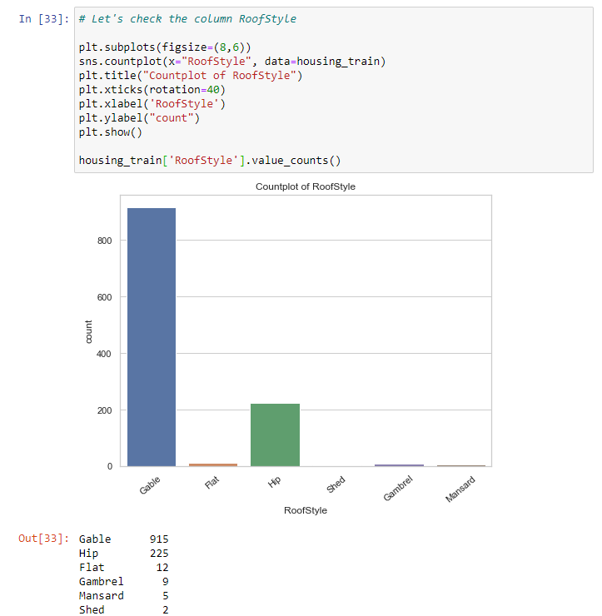
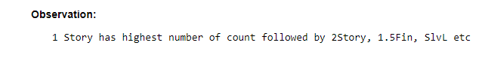
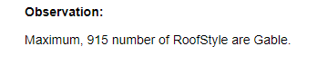
VISUALIZATIONS

Slide 42
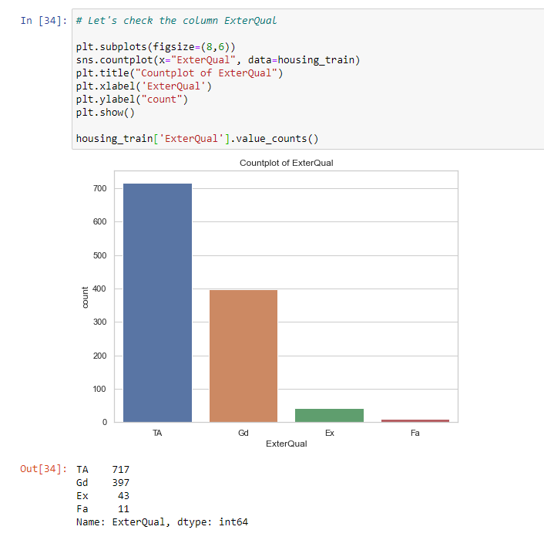
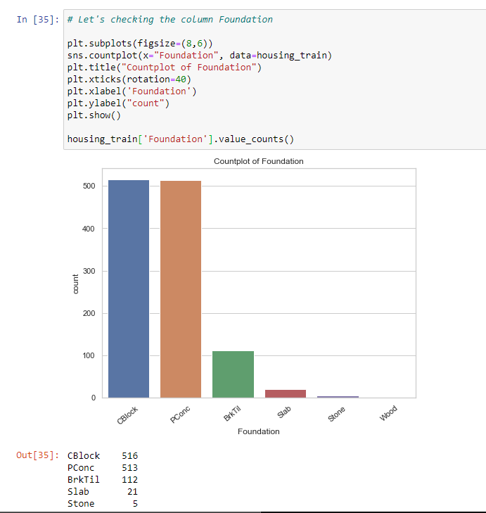
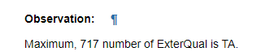
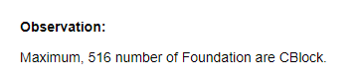
VISUALIZATIONS

Slide 43
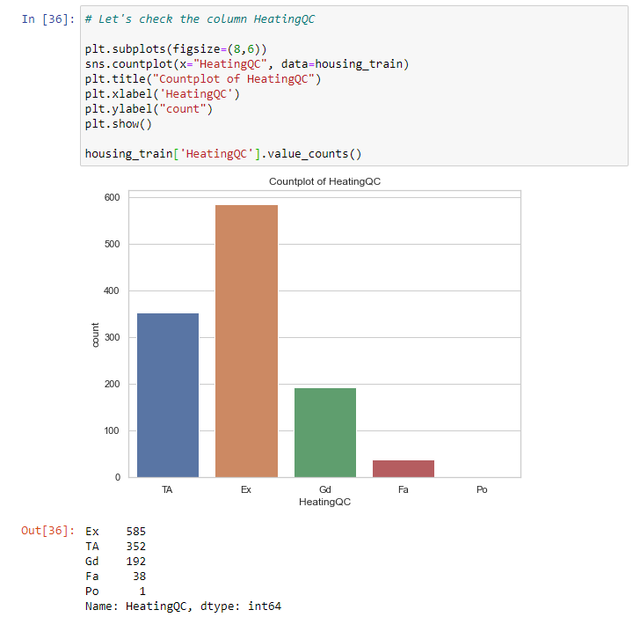
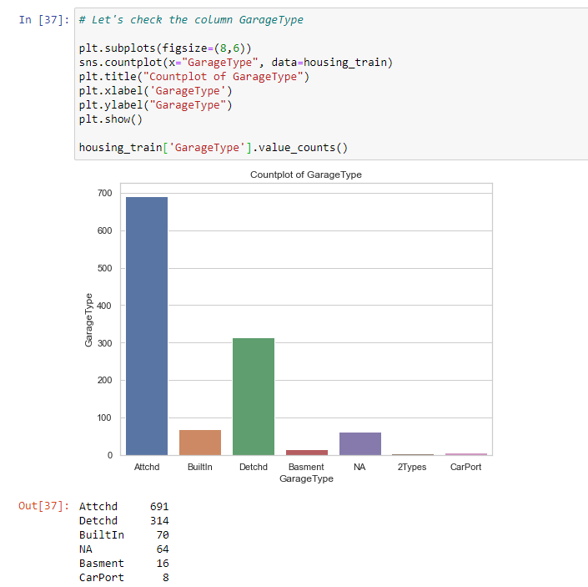
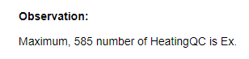

VISUALIZATIONS

Slide 44


VISUALIZATIONS

Slide 45


VISUALIZATIONS

Slide 46



VISUALIZATIONS

Slide 47



VISUALIZATIONS

Slide 48



VISUALIZATIONS

Slide 49



VISUALIZATIONS

Slide 50



VISUALIZATIONS

Slide 51


VISUALIZATIONS

Slide 52

VISUALIZATIONS

Slide 53



Slide 54


VISUALIZATIONS

Slide 55


VISUALIZATIONS

Slide 56


VISUALIZATIONS

Slide 57

VISUALIZATIONS

Slide 58


Factor Plot

Slide 59




VISUALIZATIONS

Slide 60




VISUALIZATIONS

Slide 61




VISUALIZATIONS

Slide 62




VISUALIZATIONS

Slide 63


VISUALIZATIONS

Slide 64


VISUALIZATIONS

Slide 65

VISUALIZATIONS

Slide 66


# Let's plot the pairplot
sns.pairplot(df, vars=['SalePrice','OverallQual','YearBuilt','GrLivArea','GarageCars']);

Slide 67
SET OF ASSUMPTIONS RELATED TO THE PROBLEM UNDER CONSIDERATION
By looking into the target variable label, we assumed that it was a Regression type of problem.
We observed multicollinearity in between columns so we assumed that we will be using Principal Component Analysis (PCA).
We also observed that only one single unique value was present in Utilities column so we assumed that we will be dropping this columns.

Slide 68
INTERPRETATION OF THE RESULTS
From the visualization we interpreted that the target variable SalePrice was highly positively correlated with the columns GrLivArea, YearBuilt, OverallQual, GarageCars, GarageArea.
From the preprocessing we interpreted that data was improper scaled.

Slide 69

INTERPRETATION OF THE RESULTS
From the modeling we interpreted that after hyperparameter tuning Gradient Boosting Regressor works best with respect to our model with minimum RMSE of 29516

Slide 70

CONCLUSION
In this project we have tried to show how the house prices vary and what are the factors related to the changing of house prices.
The best(minimum) RMSE score was achieved using the best parameters of Gradient Boosting Regressor

